Slide 1
Fundamentals of Computer Networks
Lecture 16
CT4005NI - Computer Hardware and Software
Architectures

Slide 2
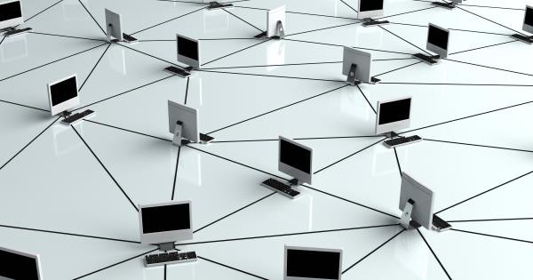
16.Introduction
This chapter provides an overview of network principles, standards, and purposes.
Objectives
Principles of networking.
Types of networks.
Basic networking concepts and technologies.
Physical components of a network.
LAN topologies and architectures.

Slide 3
16.1 Principles of Networking
10.1.1 Computer Networks
A computer data network is a collection of hosts connected by networking devices.
A host is any device that sends and receives information on the network.
Peripherals are devices that are connected to hosts. Example: Printer
Computer networks are used globally in businesses, homes, schools, and government agencies.
Different Types of devices can connect to the network. Example, Computer, Printer, Smart phones and so forth.

Slide 4
16.1 Principles of Networking
16.1.1 Computer Networks
Resources shared in a Network
Services, such as printing or scanning and Applications, such as databases.
Storage space on removable devices, such as hard drives or optical drives
Connections used to Link Network Devices
Copper cabling – Uses electrical signals to transmit data between devices
Fiber-optic cabling – Uses glass or plastic wire, also called fiber, to carry information as light pulses
Wireless connection – Uses radio signals, infrared technology, or satellite transmissions

Slide 5
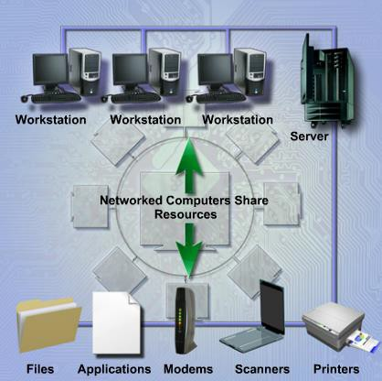
16.1 Principles of Networking
16.1.2 Benefit of Networking
Fewer Peripherals Needed
Various devices like Printer, Scanner or Backup devices can be shared and managed in a network.
Increased Communication Capabilities
Several collaboration tools like Email, Forums, Instant Messaging can be used to communicate between network users.

Slide 6
16.1 Principles of Networking
Avoid File Duplication and Corruption
A server manages network resources, share and store data, classify confidential data, and prevents from corrupting the integrity of files using Document Tracking Software.
Lower Cost Licensing
One can reduce license cost for individual computer by using Site License for entire organization for a single fee.
Centralized Administration
Centralized administration reduces the number of people needed to manage the devices and data on the network, reducing time and cost to the company.

Slide 7
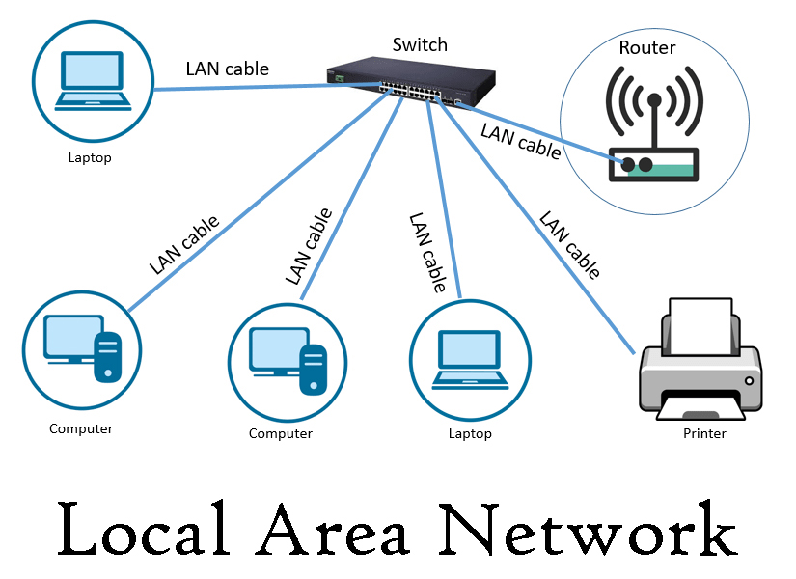
16.2 Types of Networks
16.2.1 LAN
A LAN is a group of interconnected devices that is under the same administrative control.
Traditionally, LANs were considered to be small networks that existed in a single physical location.
However, it has evolved to include interconnected local networks consisting many hundreds of devices, located in multiple buildings and location, but within same administrative control.
Notes:
image:https://www.google.com/url?sa=i&url=https%3A%2F%2Fwww.itrelease.com%2F2021%2F04%2Fwhat-is-local-area-network-lan-in-computer%2F&psig=AOvVaw3yf-mL4-HXyenFBqB_ihDl&ust=1624242732743000&source=images&cd=vfe&ved=0CAoQjRxqFwoTCOCAzqeWpfECFQAAAAAdAAAAABAQ

Slide 8
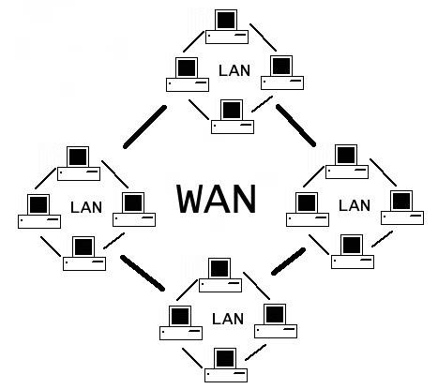
16.2 Types of Networks
16.2.2 WAN
A WAN is a network that connects LANs in geographically separated locations.
The most common example of a WAN is the Internet.
The Internet is a large WAN that is composed of millions of interconnected LANs, interconnected by Telecommunication service providers.

Slide 9
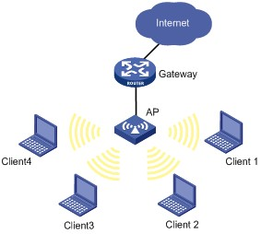
16.2 Types of Networks
16.2.3 Wireless LAN
In some environments, installing copper cabling might not be practical, desirable, or even possible.
Hence, radio waves can be used to transmit and receive data.
These networks are called wireless LANs, or WLANs.
As with LANs, on a WLAN you can share resources, such as files and printers, and access the Internet.

Slide 10
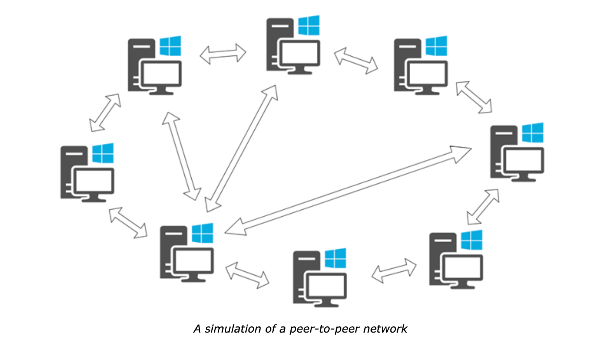
16.2 Types of Networks
16.2.4 Peer-to-Peer Networks
There are no dedicated servers or hierarchy among the computers, meaning each device has equivalent capabilities and responsibilities.
Peer-to-peer networks work best in environments with ten or fewer computers.
Disadvantages
There is no centralized network administration.
There is no centralized security.
The network becomes more difficult to manage increasing number of computers.
There might be no centralized data storage.
Notes:
image:https://mysterium.network/wp-content/uploads/2020/06/image5.jpg

Slide 11
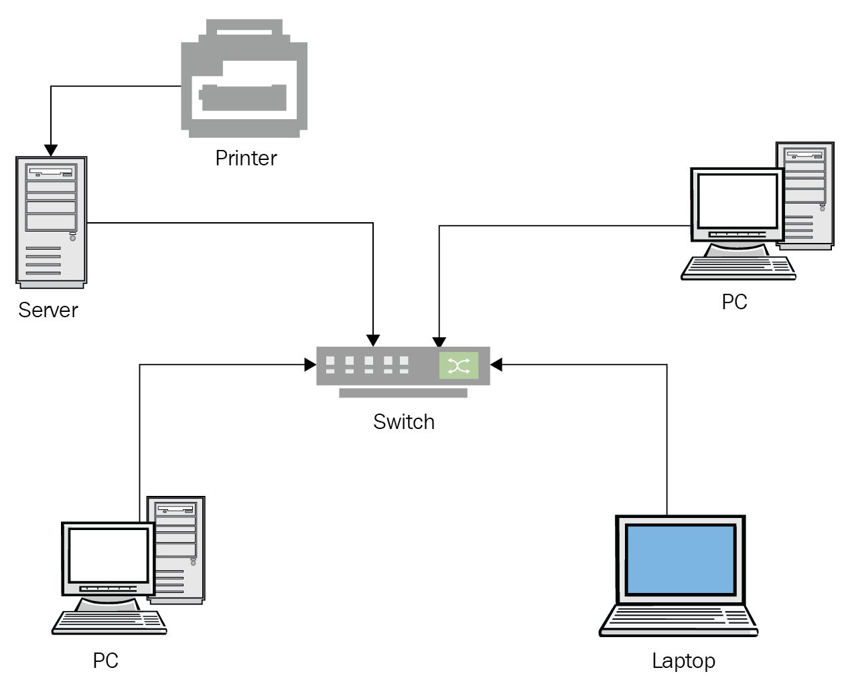
16.2 Types of Networks
16.2.5 Client/Server Networks
In a client/server network, the client requests information or services from the server.
Servers commonly perform some of the processing work for client machines.
Example:
Sorting database before delivering records to the client.
Company's email server to send, receive, and store email.
Network administrators maintain the servers for data backups and security measures.
For data protection, an administrator performs a routine backup of all the files on the servers.

Slide 12
16.2 Types of Networks
16.2.5 Client/Server Networks
A workgroup is a collection of workstations and servers on a LAN that are designed to communicate and exchange data with one another.
A domain is a group of computers and electronic devices with a common set of rules and procedures administered as a unit.
Does not refer to a single location or specific type of network configuration.
A specialized server called a domain controller manages all security-related aspects of users and network resources, centralizing security and administration.

Slide 13
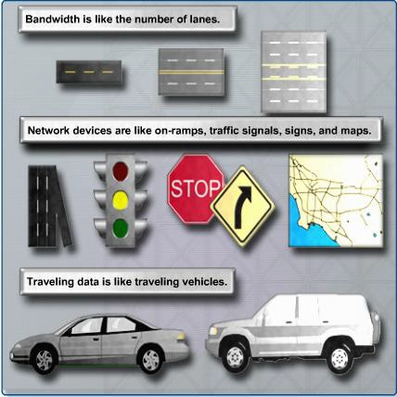
16.3 Basic Networking Concepts and Technologies
16.3.1 Bandwidth and Data Transmission

Slide 14
16.3 Basic Networking Concepts and Technologies
16.3.1 Bandwidth and Data Transmission
Bandwidth is the amount of data that can be transmitted within a fixed time period.
Bandwidth is measured in bits per second.
bps – bits per second
kbps – kilobits per second
mbps – megabits per second
1 byte (B) = 8 bits (b). Therefore, 1 MBps = 8 Mbps

Slide 15
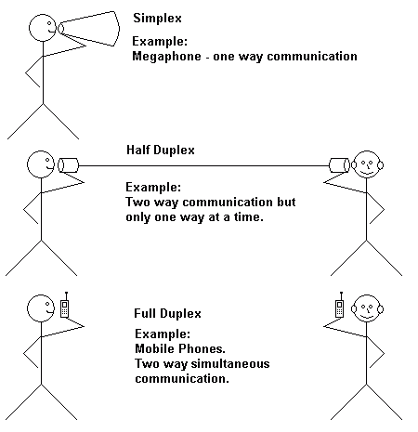
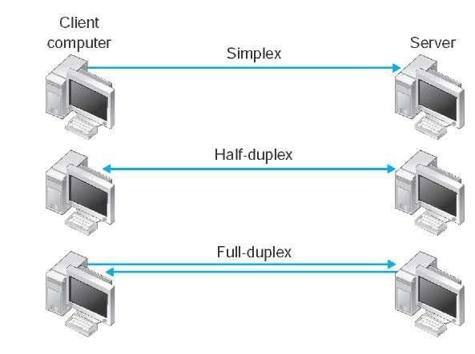
16.3 Basic Networking Concepts and Technologies
Data Transmission Types:
Simplex: One-way transmission of data. Example: Television Signal.
Half-Duplex: One direction at a time. Example: Walkie-Talkie.
Full-Duplex: Both Direction at the same time. Example: Telephone Conversation.

Slide 16
End of Lecture 16

